Slide 1
Physical Layer and Media
bmuwonge@cit.ac.ug
Data Communication And Computer networks

Slide 2
To be transmitted, data must be transformed to electromagnetic signals.
bmuwonge@cit.ac.ug
Data Communication And Computer networks

Slide 3


Analog and Digital Data
Analog and Digital Signals
Periodic and Nonperiodic Signals
Sine Wave
Wavelength
Time and Frequency Domain
Composite Signals
Bandwidth
bmuwonge@cit.ac.ug
Data Communication And Computer networks

Slide 4

Note
Data can be analog or digital.
Analog data are continuous and take continuous values.
Digital data have discrete states and take discrete values.
bmuwonge@cit.ac.ug
Data Communication And Computer networks

Slide 5
Note
Signals can be analog or digital.
Analog signals can have an infinite number of values in a range; digital signals can have only a limited
number of values.
bmuwonge@cit.ac.ug
Data Communication And Computer networks

Slide 6

Figure 1 Comparison of analog and digital signals
bmuwonge@cit.ac.ug
Data Communication And Computer networks

Slide 7
Note
In data communications, we commonly use periodic analog signals and nonperiodic digital signals.
bmuwonge@cit.ac.ug
Data Communication And Computer networks

Slide 8

bmuwonge@cit.ac.ug
Data Communication And Computer networks

Slide 9

Figure 2 A sine wave
bmuwonge@cit.ac.ug
Data Communication And Computer networks

Slide 10
Note
See discussion on mathematical approach to sine waves in Appendix C.
bmuwonge@cit.ac.ug
Data Communication And Computer networks

Slide 11
Example 1
The power in your house can be represented by a sine wave with a peak amplitude of 155 to 170 V. However, it is common knowledge that the voltage of the power in U.S. homes is 110 to 120 V. This discrepancy is due to the fact that these are root mean square (rms) values. The signal is squared and then the average amplitude is calculated. The peak value is equal to 2^{½} × rms value.
bmuwonge@cit.ac.ug
Data Communication And Computer networks

Slide 12

Two signals with the same phase and frequency, but different amplitudes
bmuwonge@cit.ac.ug
Data Communication And Computer networks

Slide 13

Note
Frequency and period are the inverse of each other.
bmuwonge@cit.ac.ug
Data Communication And Computer networks

Slide 14

Two signals with the same amplitude and phase, but different frequencies
bmuwonge@cit.ac.ug
Data Communication And Computer networks

Slide 15


Table 1 Units of period and frequency
Example 3
The power we use at home has a frequency of 60 Hz. Determine the period of this sine wave.
bmuwonge@cit.ac.ug
Data Communication And Computer networks

Slide 16

Example 4
Express a period of 100 ms in microseconds.
Solution
From Table 3.1 we find the equivalents of 1 ms (1 ms is 10⁻³ s) and 1 s (1 s is 10⁶ μs). We make the following substitutions:.
Example 5
The period of a signal is 100 ms. What is its frequency in kilohertz?
Solution
First we change 100 ms to seconds. Recall: (1 Hz = 10⁻³ kHz).
bmuwonge@cit.ac.ug
Data Communication And Computer networks

Slide 17
Note
Frequency is the rate of change with respect to time.
Change in a short span of time
means high frequency.
Change over a long span of
time means low frequency.
bmuwonge@cit.ac.ug
Data Communication And Computer networks

Slide 18
Note
If a signal does not change at all, its frequency is zero.
If a signal changes instantaneously, its frequency is infinite.
bmuwonge@cit.ac.ug
Data Communication And Computer networks

Slide 19
A sine wave with a phase of 0° starts at time 0 with a zero amplitude. The amplitude is increasing.
A sine wave with a phase of 90° starts at time 0 with a peak amplitude. The amplitude is decreasing.
A sine wave with a phase of 180° starts at time 0 with a zero amplitude. The amplitude is decreasing.
Alternatively, we can look at the phase in terms of shift or offset. We can say that:
  A sine wave with a phase of 0° is not shifted.
  A sine wave with a phase of 90° is shifted to the left by ¼ cycle. However, note that the signal does not really exist before time O.
  A sine wave with a phase of 180° is shifted to the left by ½ cycle.
bmuwonge@cit.ac.ug
Data Communication And Computer networks

Slide 20

Phase describes the position of the waveform relative to time 0.
Three sine waves with the same amplitude and frequency, but different phases
bmuwonge@cit.ac.ug
Data Communication And Computer networks

Slide 21

Example 6
A sine wave is offset 1/6 cycle with respect to time 0. What is its phase in degrees and radians?
Solution
We know that 1 complete cycle is 360°. Therefore, 1/6 cycle is
bmuwonge@cit.ac.ug
Data Communication And Computer networks

Slide 22

Wavelength
Wavelength is another characteristic of a signal traveling through a transmission medium.
While the frequency of a signal is independent of the medium, the wavelength depends on both the frequency and the medium.
The wavelength is the distance a simple signal can travel in one period.
λf = c
Figure 6 Wavelength and period
bmuwonge@cit.ac.ug
Data Communication And Computer networks

Slide 23

Figure 7 The time-domain and frequency-domain plots of a sine wave
bmuwonge@cit.ac.ug
Data Communication And Computer networks

Slide 24
Note
A complete sine wave in the time domain can be represented by one single spike in the frequency domain.
bmuwonge@cit.ac.ug
Data Communication And Computer networks

Slide 25
Example 7
The frequency domain is more compact and useful when we are dealing with more than one sine wave.
For example, Figure 8 shows three sine waves, each with different amplitude and frequency.
All can be represented by three spikes in the frequency domain.
bmuwonge@cit.ac.ug
Data Communication And Computer networks

Slide 26

Figure 8 The time domain and frequency domain of three sine waves
bmuwonge@cit.ac.ug
Data Communication And Computer networks

Slide 27
Note
A single-frequency sine wave is not useful in data communications;
we need to send a composite signal, a signal made of many simple sine waves.
bmuwonge@cit.ac.ug
Data Communication And Computer networks

Slide 28
Note
According to Fourier analysis, any composite signal is a combination of
simple sine waves with different frequencies, amplitudes, and phases.
Fourier analysis is discussed in Appendix C.
bmuwonge@cit.ac.ug
Data Communication And Computer networks

Slide 29
Note
If the composite signal is periodic, the decomposition gives a series of signals with discrete frequencies;
if the composite signal is nonperiodic, the decomposition gives a combination of sine waves with continuous frequencies.
bmuwonge@cit.ac.ug
Data Communication And Computer networks

Slide 30
Example 8
Figure 9 shows a periodic composite signal with frequency f. This type of signal is not typical of those found in data communications.
We can consider it to be three alarm systems, each with a different frequency.
The analysis of this signal can give us a good understanding of how to decompose signals.
bmuwonge@cit.ac.ug
Data Communication And Computer networks

Slide 31

Figure 9 A composite periodic signal
bmuwonge@cit.ac.ug
Data Communication And Computer networks

Slide 32

Figure 10 Decomposition of a composite periodic signal in the time and
frequency domains
bmuwonge@cit.ac.ug
Data Communication And Computer networks

Slide 33
Example 9
Figure 11 shows a non-periodic composite signal. It can be the signal created by a microphone or a telephone set when a word or two is pronounced. In this case, the composite signal cannot be periodic, because that implies that we are repeating the same word or words with exactly the same tone.
bmuwonge@cit.ac.ug
Data Communication And Computer networks

Slide 34

Figure 11 The time and frequency domains of a non-periodic signal
bmuwonge@cit.ac.ug
Data Communication And Computer networks

Slide 35
Note
The bandwidth of a composite signal is the difference between the
highest and the lowest frequencies contained in that signal.
bmuwonge@cit.ac.ug
Data Communication And Computer networks

Slide 36

Figure 12 The bandwidth of periodic and non-periodic composite signals
bmuwonge@cit.ac.ug
Data Communication And Computer networks

Slide 37

Example 3.10
If a periodic signal is decomposed into five sine waves with frequencies of 100, 300, 500, 700, and 900 Hz, what is its bandwidth? Draw the spectrum, assuming all components have a maximum amplitude of 10 V.
Solution
Let f_{h} be the highest frequency, f_{l} the lowest frequency, and B the bandwidth. Then
The spectrum has only five spikes, at 100, 300, 500, 700, and 900 Hz (see Figure 3.13).
bmuwonge@cit.ac.ug
Data Communication And Computer networks

Slide 38

Figure 13 The bandwidth for Example 10
bmuwonge@cit.ac.ug
Data Communication And Computer networks

Slide 39
Example 11
A periodic signal has a bandwidth of 20 Hz. The highest frequency is 60 Hz. What is the lowest frequency? Draw the spectrum if the signal contains all frequencies of the same amplitude.
Solution
Let f_{h} be the highest frequency, f_{l} the lowest frequency, and B the bandwidth. Then
The spectrum contains all integer frequencies. We show this by a series of spikes (see Figure 3.14).
bmuwonge@cit.ac.ug
Data Communication And Computer networks

Slide 40

Figure 14 The bandwidth for Example 3.11
bmuwonge@cit.ac.ug
Data Communication And Computer networks

Slide 41
Example 3.12
A nonperiodic composite signal has a bandwidth of 200 kHz, with a middle frequency of 140 kHz and peak amplitude of 20 V. The two extreme frequencies have an amplitude of 0. Draw the frequency domain of the signal.
Solution
The lowest frequency must be at 40 kHz and the highest at 240 kHz. Figure 3.15 shows the frequency domain and the bandwidth.
bmuwonge@cit.ac.ug
Data Communication And Computer networks

Slide 42

Figure 3.15 The bandwidth for Example 3.12
bmuwonge@cit.ac.ug
Data Communication And Computer networks

Slide 43
Example 13
An example of a nonperiodic composite signal is the signal propagated by an AM radio station. In the United States, each AM radio station is assigned a 10-kHz bandwidth. The total bandwidth dedicated to AM radio ranges from 530 to 1700 kHz. We will show the rationale behind this 10-kHz bandwidth in Chapter 5.
bmuwonge@cit.ac.ug
Data Communication And Computer networks

Slide 44
Example 14
Another example of a nonperiodic composite signal is the signal propagated by an FM radio station. In the United States, each FM radio station is assigned a 200-kHz bandwidth. The total bandwidth dedicated to FM radio ranges from 88 to 108 MHz. We will show the rationale behind this 200-kHz bandwidth in Chapter 5.
bmuwonge@cit.ac.ug
Data Communication And Computer networks

Slide 45


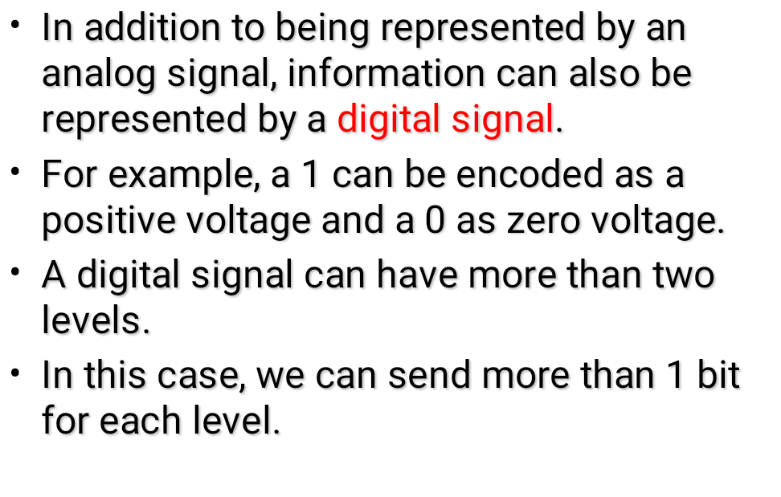
bmuwonge@cit.ac.ug
Data Communication And Computer networks

Slide 46

Figure 3.16 Two digital signals: one with two signal levels and the other
with four signal levels
bmuwonge@cit.ac.ug
Data Communication And Computer networks

Slide 47
We send 1 bit per level in part a of the figure and 2 bits per level in part b of the figure.
In general, if a signal has L levels, each level needs log₂L bits.
Example 3.16
A digital signal has eight levels. How many bits are needed per level?
We calculate the number of bits from the formula.
Each signal level is represented by 3 bits.
bmuwonge@cit.ac.ug
Data Communication And Computer networks

Slide 48
Example
A digitized voice channel, is made by digitizing a 4-kHz bandwidth analog voice signal. We need to sample the signal at twice the highest frequency (two samples per hertz). We assume that each sample requires 8 bits. What is the required bit rate?
Solution
The bit rate can be calculated as
bmuwonge@cit.ac.ug
Data Communication And Computer networks

Slide 49
Example 3.20
What is the bit rate for high-definition TV (HDTV)?
Solution
HDTV uses digital signals to broadcast high quality video signals. The HDTV screen is normally an aspect ratio of 16 : 9. There are 1920 by 1080 pixels per screen, and the screen is renewed 30 times per second. Twenty-four bits represents one color pixel.
The TV stations reduce this rate to 20 to 40 Mbps through compression.
NB: The aspect ratio of an image is the ratio of the width of the image to its height
bmuwonge@cit.ac.ug
Data Communication And Computer networks

Slide 50
Digital Signal as a Composite Analog Signal
If the digital signal is periodic, the decomposed signal has a frequency domain representation with an infinite bandwidth and discrete frequencies.
If the digital signal is non-periodic, the decomposed signal still has an infinite bandwidth, but the frequencies are continuous.
bmuwonge@cit.ac.ug
Data Communication And Computer networks

Slide 51

Figure 3.17 The time and frequency domains of periodic and non-periodic
digital signals
bmuwonge@cit.ac.ug
Data Communication And Computer networks

Slide 52
Transmission of Digital Signals
How can we send a digital signal from point A to point B?
We can transmit a digital signal by using one of two different approaches:
  Baseband transmission or
  Broadband transmission(using modulation).
bmuwonge@cit.ac.ug
Data Communication And Computer networks

Slide 53
Baseband transmission
Here, we send a digital signal over a channel without changing the digital signal to an analog signal.
Baseband transmission requires that we have a low-pass channel,
  A channel with a bandwidth that starts from zero.
  This is the case if we have a dedicated medium with a bandwidth constituting only one channel.
    For example, the entire bandwidth of a cable connecting two computers is one single channel.
    As another example, we may connect several computers to a bus, but not allow more than two stations to communicate at a time.
bmuwonge@cit.ac.ug
Data Communication And Computer networks

Slide 54

Figure 18 Baseband transmission
A digital signal is a composite analog signal with an infinite bandwidth.
bmuwonge@cit.ac.ug
Data Communication And Computer networks

Slide 55
Broadband in telecommunications refers to a signaling method that includes or handles a relatively wide range (or band) of frequencies, which may be divided into channels.
The wider (or broader) the bandwidth of a channel, the greater the information-carrying capacity.
In radio, for example, a broader band is required to carry music without losing the high audio frequencies required for realistic sound reproduction.
A television antenna described as "broadband" may be capable of receiving a wide range of channels; while a single-frequency or Lo-VHF antenna is "narrowband" since it only receives 1 to 5 channels.
bmuwonge@cit.ac.ug
Data Communication And Computer networks

Slide 56
In a baseband transmission, the entire bandwidth of the cable is consumed by a single signal.
In broadband transmission, signals are sent on multiple frequencies, allowing multiple signals to be sent simultaneously.
Baseband Signaling:
  1)Uses digital signaling
  2)No frequency-division multiplexing
  3)Bi-directional transmission
  4)Signal travels over short distances
Broadband Signaling:
  1)Uses analog signaling
  2)Unidirectional transmission
  3)Frequency-division multiplexing is possible
  4)Signal can travel over long distances before being attenuated
bmuwonge@cit.ac.ug
Data Communication And Computer networks

Slide 57
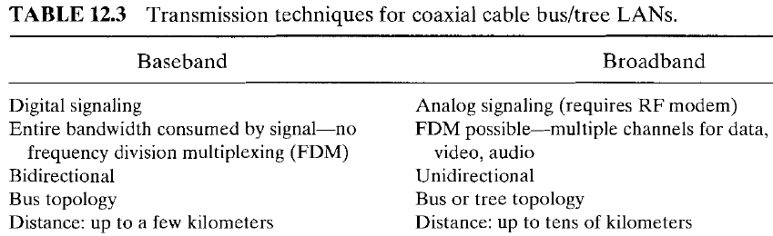
bmuwonge@cit.ac.ug
Data Communication And Computer networks

Slide 58
Low-Pass Channel with Wide Bandwidth
If we want to preserve the exact form of a non-periodic digital signal with vertical segments vertical and horizontal segments horizontal, we need to send the entire spectrum,
  The continuous range of frequencies between zero and infinity.
This is possible if we have a dedicated medium with an infinite bandwidtth between the sender and receiver that preserves the exact ampliude of each component of the composite signal.
  This may be possible inside a computer[e. g between CPU & memory] but not between 2 communicating devices.
  Possible with a medium, such as a coaxial cable or fiber optic, with a very wide bandwidth.
bmuwonge@cit.ac.ug
Data Communication And Computer networks

Slide 59

Figure 19 Bandwidths of two low-pass channels
bmuwonge@cit.ac.ug
Data Communication And Computer networks

Slide 60

Figure 20 Baseband transmission using a dedicated medium
Baseband transmission of a digital signal that preserves the shape of the digital signal is possible only if we have a low-pass channel with an infinite or very wide bandwidth.
bmuwonge@cit.ac.ug
Data Communication And Computer networks

Slide 61
Example 21
An example of a dedicated channel where the entire bandwidth of the medium is used as one single channel is a LAN.
Almost every wired LAN today uses a dedicated channel for two stations communicating with each other.
In a bus topology LAN with multipoint connections, only two stations can communicate with each other at each moment in time (timesharing); the other stations need to refrain from sending data.
In a star topology LAN, the entire channel between each station and the hub is used for communication between these two entities.
bmuwonge@cit.ac.ug
Data Communication And Computer networks

Slide 62
Low-Pass Channel with Ltd Bandwidth
In a low-pass channel with limited bandwidth, we approximate the digital signal with an analog signal.
The level of approximation depends on the bandwidth available.
Rough Approximation: Take a digital signal of bit rate N
To simulate the two cases of 010101… and 101010…, we need an analog signal of frequency f = N/2. Let 1 be the positive peak value and 0 be the negative peak value.
We send 2 bits in each cycle; the frequency of the analog signal is one-half of the bit rate, or N/2.
bmuwonge@cit.ac.ug
Data Communication And Computer networks

Slide 63

Rough approximation of a digital signal using the first harmonic for worst case
bmuwonge@cit.ac.ug
Data Communication And Computer networks

Slide 64

Figure 22 Simulating a digital signal with first three harmonics
bmuwonge@cit.ac.ug
Data Communication And Computer networks

Slide 65
Note
In baseband transmission, the required bandwidth is proportional to the bit rate;
if we need to send bits faster, we need more bandwidth.
In baseband transmission, the required bandwidth is proportional to the bit rate;
if we need to send bits faster, we need more bandwidth.
bmuwonge@cit.ac.ug
Data Communication And Computer networks

Slide 66

Table 3.2 Bandwidth requirements
bmuwonge@cit.ac.ug
Data Communication And Computer networks

Slide 67
Example 3.22
We have a low-pass channel with bandwidth 100 kHz. What is the maximum bit rate of this channel?
Solution
The maximum bit rate can be achieved if we use the first harmonic. The bit rate is 2 times the available bandwidth, or 200 kbps.
bmuwonge@cit.ac.ug
Data Communication And Computer networks

Slide 68

Figure 3.23 Bandwidth of a band pass channel
bmuwonge@cit.ac.ug
Data Communication And Computer networks

Slide 69
Note
If the available channel is a bandpass channel, we cannot send the digital signal directly to the channel;
we need to convert the digital signal to an analog signal before transmission.
bmuwonge@cit.ac.ug
Data Communication And Computer networks

Slide 70

Q & A
“In life, always expect questions, but do not expect answers”
bmuwonge@cit.ac.ug
Data Communication And Computer networks

